Slide 1


Welcome!
Vinod Kumar, CTO – EduArn.com
EduArn.com | AI Webinar

Slide 2


ENTERPRISE HR POLICY AI ASSISTANT
Build a Local RAG-Powered HR Knowledge Assistant
Powered by:
Python
LangChain
ChromaDB
Hugging Face Embeddings
Ollama
Qwen 2.5
Streamlit
EduArn.com | AI Webinar

Slide 3

THE HR PROBLEM
Traditional HR Policy Search
Employees often need answers to questions like:
How many annual leaves can I take?
What is the notice period?
The challenge:
📄 Large policy documents
🔎 Manual searching
⏱️ Time-consuming HR queries
❓ Difficult for employees to find the right information
2

Slide 4

THE SOLUTION
🤖 HR Policy AI Assistant
A conversational AI system that allows employees to ask questions in natural language and receive answers based on organizational HR policy documents.
What it does
Upload Policy → Understand Documents → Retrieve Relevant Content → Generate Answer → Show Sources
AI answers from the organization's knowledge base rather than relying only on general model knowledge.
3

Slide 5
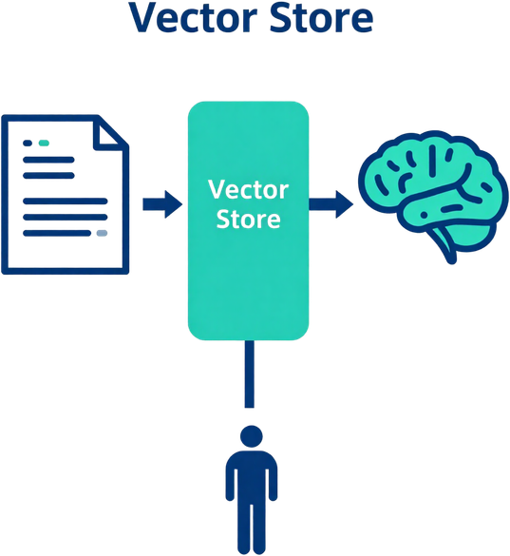
WHAT IS RAG?
Retrieval-Augmented Generation
What do you know about HR policies?”
we use:
Employee Question
↓
Search HR Knowledge Base
↓
Retrieve Relevant Policy Sections
↓
Give Retrieved Context to LLM
↓
Generate Grounded Answer
↓
Show Source Pages
4

Slide 6


SOLUTION ARCHITECTURE
📄 HR POLICY PDF
│
▼
PyPDFLoader
│
▼
Text Chunking
│
▼
🧠 MiniLM Embeddings
│
▼
🗄️ ChromaDB
Vector Knowledge Base
│
👤 Employee Question
│
▼
🔎 Similarity Search
│
▼
Relevant Policy Chunks
│
▼
LangChain RAG
│
▼
🤖 Ollama + Qwen 2.5
│
▼
💬 HR Answer
│
▼
📑 Source Page Numbers
5

Slide 7

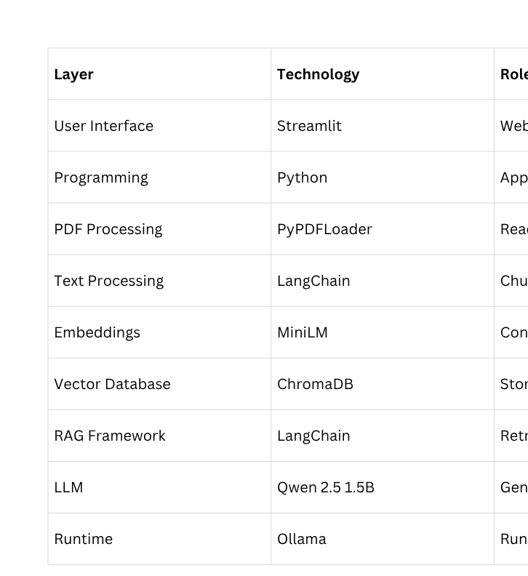
TECHNOLOGY STACK
6

Slide 8
HOW THE KNOWLEDGE BASE IS CREATED
Document Ingestion Pipeline
1. Upload
HR uploads a policy PDF.
↓
2. Extract
PyPDFLoader extracts document text.
↓
3. Chunk
Large documents are divided into smaller meaningful sections.
↓
4. Embed
MiniLM converts each section into a vector representation.
↓
5. Store
Vectors are stored in ChromaDB.
Result
The HR policy becomes searchable using semantic similarity.
7

Slide 9


HOW A QUESTION IS ANSWERED
Employee Question
↓
Create Query Embedding
↓
Search ChromaDB
↓
Retrieve Top 4 Relevant Chunks
↓
Build Context
↓
Send Context + Question
↓
Qwen 2.5
↓
HR Policy Answer
↓
Display Source Pages
RAG inference pipeline.
8

Slide 10
WHAT ELSE CAN WE BUILD?
Enterprise Features
🔐 Role-based access
👥 Employee authentication
📚 Multiple policy documents
🌐 Multi-language support
📈 Usage analytics
📝 Audit logs
From Prototype to Enterprise HR AI Platform
Employee Self-Service
💬 HR policy Q&A
📅 Leave information
🏠 Remote work policies
💰 Expense policies
📋 Benefits information
HR Operations
📊 Policy analytics
🔎 Policy search
📄 Document management
🔄 Policy version comparison
📌 Source tracking
9

Slide 11
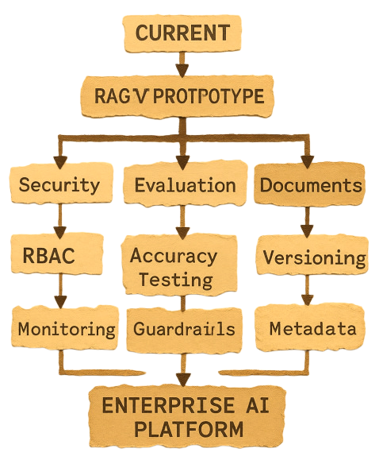
PRODUCTION ROADMAP
POC → Production
10

Slide 12
WANT TO BUILD THIS YOURSELF?
Python → LangChain → Embeddings → ChromaDB → Ollama → Qwen → Streamlit
Python Fundamentals
↓
Generative AI
↓
LLM Fundamentals
↓
Embeddings & Vector Databases
↓
RAG Applications
↓
LangChain
↓
AI Agents
↓
Production AI Applications
11

Slide 13

11

Slide 14
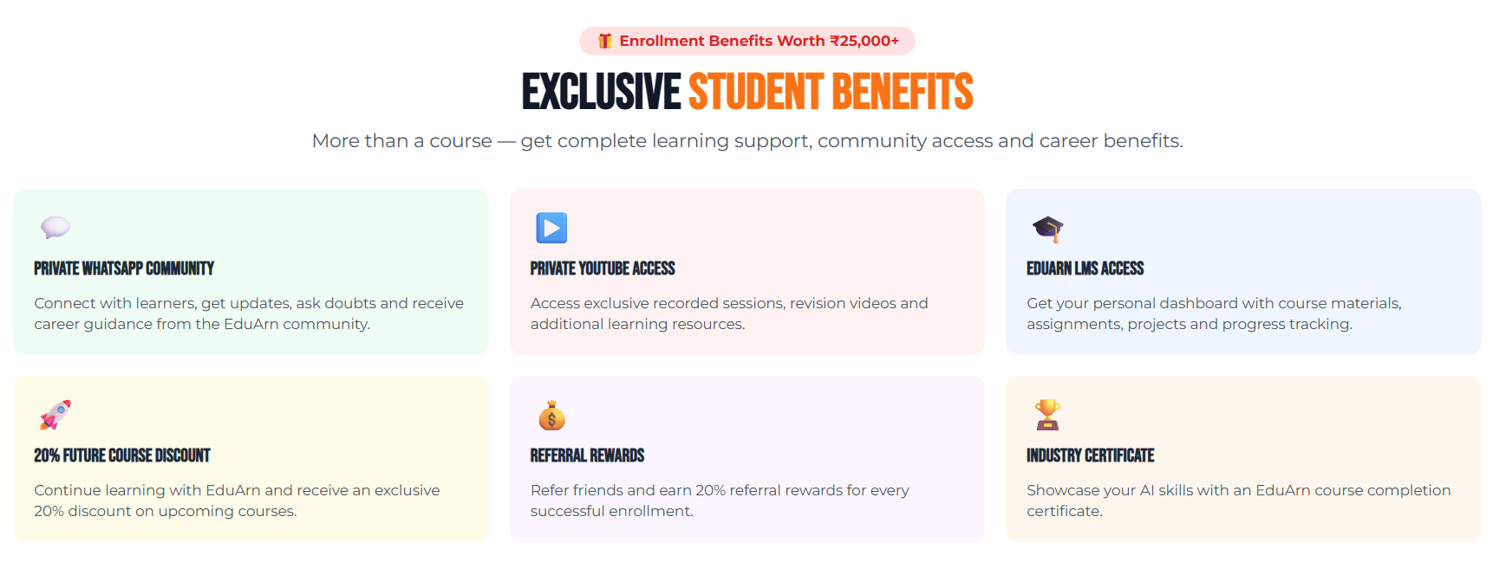
11

Slide 15
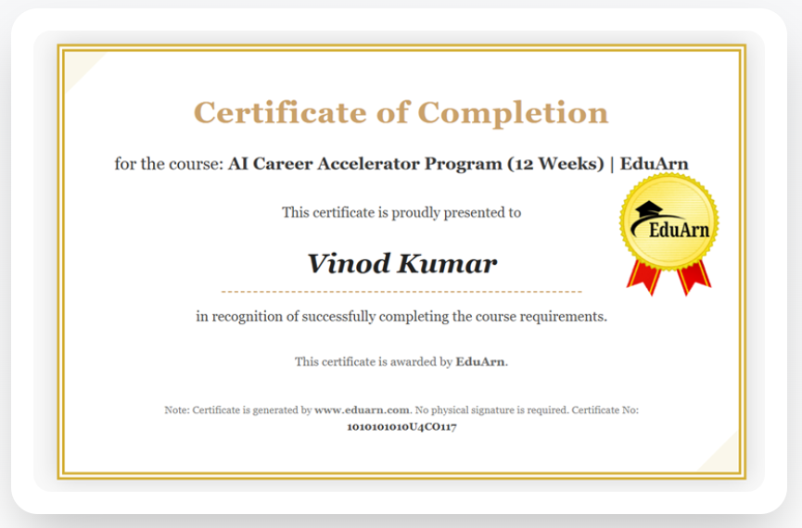
11

Slide 16

THANK YOU!

